Slide 1
Sequence model
DeepFix: Fixing Common C Language Errors by Deep Learning
An Empirical Study on Learning Bug-Fixing Patches in the Wild via Neural Machine Translation
SEQUENCER: Sequence-to-Sequence Learning for End-to-End Program Repair
2020-01-09
JuHyoung Kim
kjhkjh75@naver.com

Slide 2
Abstract
Three seq to seq model for apr model
Deepfix, Tufano et al, sequencer
Same model, but different processing.

Slide 3
Feature.
Deepfix
C languages.
Deep learning sequence to sequence model
End to end solution
No external tool ,use only compiler
Attention mechanism
Integer literal - >NUM, string literal -> STR
To predicting the target sequence of similar size accurately
->encode line number
Predict only a single fix
To fix multiple errors
-> iterate process
Compiler is used to decide whether to accept the fix or not as Oracle

Slide 4
Feature.
Michele
Java Languages
Method level
Sequence to sequence model
Using past history of open source repository
Method –level AST,gum tree
Exclude methods created/deleted
Use Java lexer and parser to represent buggy and fixed method within a BFP
METHOD_1,METHOD_2,INT_1,STRING….etc
Some identifiers and literals appear so often in the code, keep the original text
Beam Search

Slide 5
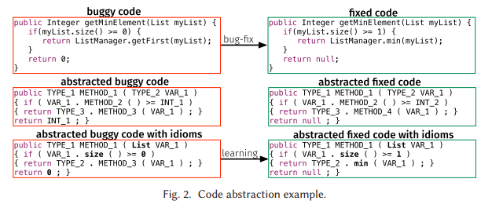
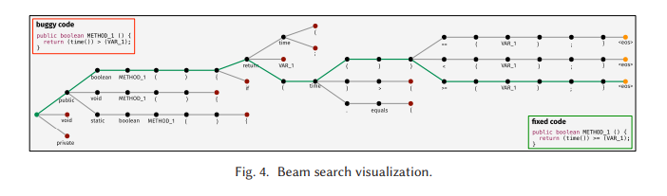
Feature.
Michele

Slide 6
Feature
Sequencer
Java languages
Class level
Open source projects.
End to end model
Copy mechanism
Fault localization technique -> identify buggy lines -> analyze how they interact with the rest of the method`s execution.
Tokenization and truncation to limit the size
Beam search and validate the patch.

Slide 7
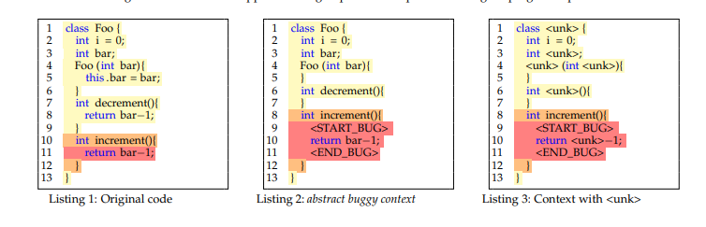
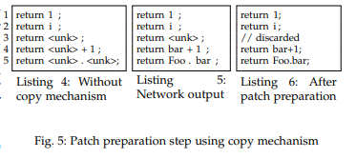
Feature
Sequencer

Slide 8
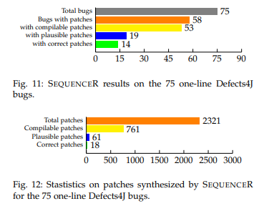
Limit
Low compliable patches and Similar code waste
- Fault localization correctness.

Slide 9
To improve
Suggestion 1
Changing the candidate patches, check the error message number.
If we have 5 errors in file and 50 candidate patches each.
Error1 – {candidate1, candidate2,…,}
Error2 – {candidate1, candidate2,…,}
Error3 – {candidate1, candidate2,…,} -> check the least number error message
Error4 – {candidate1, candidate2,…,} patch combination.
Error5 – {candidate1, candidate2,…,}
Suggestion 2
Using code similarity localize the suspicious line or delete the redundancy repair

Slide 10
Future plan
- Prove the effect of first suggestion. Using the open source code validate the first suggestion.
- Find a way or paper that can use second suggestion

